Slide 1

LENDING CLUB LOAN ANALYSIS
JOSEPH ANDERSON
TRAVIS BLACKWELL
PRATHAP HARIHARAN
APRIL 27, 2017
BIT 5534
DR. RAYMOND L. MAJOR
PROJECT GROUP #1
Notes:
Hello and thank you for taking time to view this presentation which is the result of our semester project undertaken for the course BIT5535 Applied Business Intelligence and Analytics at Virginia Tech. The project group, which consists of Travis Blackwell, Prathap Harihan and myself (Joseph Anderson) performed data mining analysis on loan data retrieved from the Lending Club web site. We would like to thank professor Raymond Major for this opportunity and his guidance during the semester. Every data set has a story to tell we hope that this presentation will help unlock the story that we found with the Lending Club data.

Slide 2
LENDING CLUB ANALYSIS OVERVIEW
Identifying the Business Problem
Data Description
Data Preparation & Processing
Data Mining
Models
Logistic Regression
Decision Trees
K-Nearest Neighbor
Neural Networks
Summary of Findings
Conclusion
Notes:
During this presentation we will move systematically through a discussion of our project. First we will give an overview of Lending Club model and the business problem that we are attempting to solve. Following this, we will briefly discuss details about our data set, how we prepared and processed the data to set up for our data mining exercise and a quick overview about our data mining approach itself. This will then be followed by a closer look at each of the four data mining methodologies we applied on the data. We will then wrap up by presenting a summary of findings followed by our conclusion of which of the data mining methodologies scored best in terms of predictive capability and what the model of choice told us about the data set itself

Slide 3
IDENTIFYING THE BUSINESS PROBLEM
Lending Club is a Peer-to-Peer lending company that utilizes a group of private investors to fund loan requests.
Lending Club’s model for risk assessment categorizes borrowers by assigning them a grade and a subgrade based on their credit history.
Investors are presented with a list of borrowers, along with their assigned risk assessment grades, and they have the opportunity to choose which borrowers they will fund, and the percentage of funding that they will cover.
Our business problem is that investors require a more comprehensive assessment of these borrowers than what is presented by Lending Club in order to make a smart business decision, by identifying new borrowers that would likely default on their loans.
Borrower
Lending Club
Investors
Notes:
Lending Club is an online peer to peer credit marketplace which matches borrowers and investors. For evaluating the credit-worthiness of their borrowers, Lending Club primarily relies on a grade and sub-grade it assigns them based on their credit-history. This rating information is then made available to investors who fund the loan requests, so that the investors can decide which loan request and how much of that loan request they will fund. In addition to the grade information, Lending Club provides historical loan performance data to investors for more comprehensive analysis. Our business problem is to find a model that will utilize the historic loan data to help better identify borrowers that are likely to default Such a model would allow investors to avoid loan defaults thus limiting the risk of their investments.

Slide 4
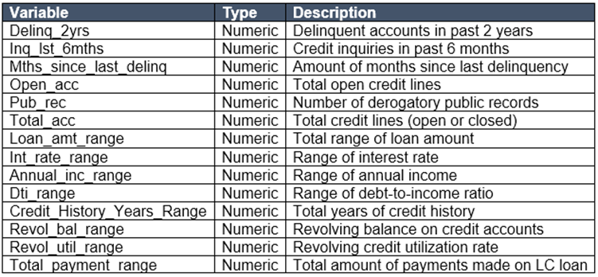
DATA DESCRIPTION
Lending Club provided us with 4 years of historical data (2012-2015). This dataset contained information pertaining to the borrower’s past credit history and Lending Club loan information. The total dataset consisted of over 800,000 records, which was sufficient for our team to conduct analysis models.
Variables present within the dataset provided an ample
amount of information which we could use to identify relationships and gauge their effect upon the success or
failure of a borrower fulfilling the terms of their loan
agreement.
We required only the variables that had a direct or indirect response to a borrower’s potential to default. To achieve this, we prepared the data by choosing select variables that would best fit this criteria.
Notes:
Lending Club provides multiple years of good quality historical loan data. We accessed over 800000 loan records compiled over a period of 4 years from 2012 through 2015. Each record represented an individual loan. These records were comprised of over 100 variables. Included in the data set was a variable that stored information as to whether that particular loan record had gone into default or had stayed current through its repayment term. We could clearly see that this variable would be our dependent variable and that we would evaluate the other relevant variables to see what influence they had over it. Thus we began our next step of evaluating the data set and cleaning and preparing it for our data mining exercise.

Slide 5
DATA PREPARATION & PROCESSING
Prior to data mining model analysis, the data was reviewed, cleaned and prepared as follows:
Removed columns that obviously had no relation to the analysis in question (E.g. Applicant ID, Employee Title etc.)
Removed columns that had bad quality data (i.e. missing values in observations, unintelligible values etc.)
Removed columns that had identical relationships to the analysis in question (E.g. funded_amnt and funded_amnt_inv as they are always the same as loan_amt)
Established derived columns from existing columns to facilitate model analysis (E.g. Credit_History_years, Converted binary dependent variable column called “default”, mths_since_last_delinq etc.)
Converted continuous variables to range of values to enhance interpretation of results (E.g. loan_amt, int_rate, Annual_income, credit_history_years, revol_util, total_pymnt etc.)
Notes:
Though the data was of good quality, we found that we had to perform some clean-up activity. We discarded variables that were redundant or obviously did not exert any influence on the dependent variable (For example: Employee ID, Borrower job title, and the credit history URL). We then removed observations that were missing data in key variables. This, however, was very small percentage of the population. Once we had trimmed the variables and record set, we converted certain continuous variables into ranges of values that would allow for a better interpretation of the results. For example, we categorized loan amounts into 10 ranges of values as we found that a loan value of say $10,000 and $10,100 did not provide any discernable difference. Finally, we converted the variable called loan status into a binary variable called “default” for use as our dependent variable.

Slide 6
DATA MINING
LOGISTIC REGRESSION
DECISION TREES
k-NEAREST NEIGHBOR
NEURAL NETWORKS
We selected four data models to determine which returned the best predictive capability. We utilized multiple assessment parameters to determine the most successful model, to include:
Confusion Matrix (Accuracy, Sensitivity and Specificity)
Receiver Operating Characteristic (ROC)
Lift Chart
R-Squared value
RMSE
Mean Abs Dev
Misclassification Rate
Loglikelihood
Notes:
We selected four data mining methodologies for our analysis, namely, Logistic Regression, Decision Tree, k-Nearest Neighbor and Neural networks. These are common dependency techniques used in data mining and are very well supported by commercial-off-the-shelf applications like the SAS Institute’s JMP Application for quick and effective data mining analysis. In addition to selecting the methodologies, we established the parameters that we were going to use for comparing these four models at the end of the data mining exercise. These parameters as listed in this slide primarily originate from the Confusion Matrix, ROC and Lift Charts and the fit measures of the models. We were specifically planning to watch for higher values of Sensitivity, Area-under-curve value from the ROC Curve and R-Squared values from the fit-measures for our comparison. We would also look for smaller values of Log likelihood, RMSE, Mean Abs Dev and Misclassification Rate. After each model was run and analyzed to determine the optimal settings, the final model was run and the predictive formulas were saved to the table for later comparison.

Slide 7
LOGISTIC REGRESSION
We selected the binary variable of default for the response/target variable and ran a multi-variate and bi-variate analysis utilizing the remaining continuous variables; assessing the model utilizing R-square values, P-values, and scatter-plot trends.
Our initial model sought to observe any notable relationships between the variables, and to filter out variables that had weak correlations toward the response variable.
After achieving a P-value of at least <0.0001, and an R-square value of 48%, we began to experiment with various variables by observing the effect of converting them into more manageable data types.
We were successful in converting a number of variables, while maintaining a 93% accuracy rate. The model was then validated by checking the linearity of the Logit, which resulted in no evidence of nonlinearity among the independent continuous variables.
Multi-Variate Analysis
Bi-Variate Analysis
Logistic Regression
Notes:
As part of our Logistic regression analysis, we performed Multi-variate and Bi-variate analysis to confirm that the variables we had selected for the data mining exercises exhibited reasonably strong correlation. We used the P-value of <0.0001 for this evaluation. Following this, we ran the Logistic regression and ascertained that the whole model test showed a R-Square value of 48%, indicating reasonably strong influence of the independent variables over the dependent variable. From the confusion matrix, we ascertained an accuracy level of 93%. We also evaluated the linearity of Logit to confirm that any continuous variables in our data set had a linear relationship between them.

Slide 8
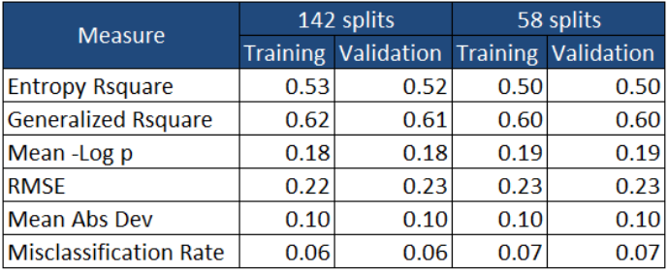
DECISION TREES
A subset of 235,629 records was utilized for testing, of which, 158,454 selected for training and 77,175 selected for validation. We performed our initial test using a recursive split, and completed the test after 142 splits with a optimal R-Square value of 0.52.
To find the minimum amount of splits, with an R Square value of 0.5, we opted to perform a manual iterative split which reached the target R-Square value of 0.5 after only 58 splits. Thus, we opted to keep the model with 58 splits.
Notes:
For the decision tree, we tried two approaches. First we had the JMP application perform an automatic recursive split and JMP arrived at an optimal 142 splits with an R-square value of 0.52. In order to confirm this, we then performed a manual iterative split and found that when we reached 58 splits, we were able to achieve an R-square value of 0.5, with further splits yielding no discernable improvement to the R-square value. Hence, we decided that we would go with 58 splits for our decision tree analysis. As you can see on this slide the fit measures support our decision of selecting 58 splits over 142 splits.

Slide 9
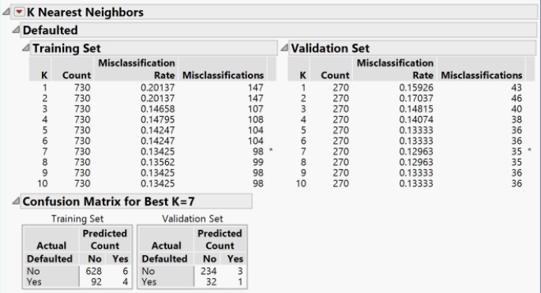
K-NEAREST NEIGHBOR
The k-nearest neighbor model utilized a random subset, consisting of 1,000 records. A preliminary model was executed in order to determine if standardization or the creation of dummy variables would improve
the accuracy of the models.
JMP applies dummy variables automatically,
so we were able to utilize the same variables
from the logistic regression trial—minus
those that presented a negligible response
from the logistic regression model.
We focused on the confusion matrix
generated by JMP in order to draw
comparisons between the the accuracy and
sensitivity of the validation data through each
iteration, while also making notations of the misclassification rate of each validation set.
Notes:
Since the k-nearest neighbor analysis is resource intensive, we selected a random subset of 1000 records from the data set for this model. Due to the fact that JMP applies normalization and dummy variables in this algorithm we found that we did not need to further prepare the data. We utilized the same variables as the logistic regression trial minus those that presented a negligible response in the logistic regression model. We ran 10 trials and found that trial 7, consisting of 7 neighbors, yielded the best misclassification rate. We selected this trial for our final comparison.

Slide 10
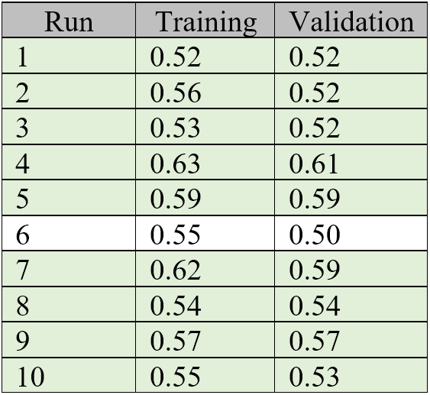
NEURAL NETWORKS
Neural Networks model utilized a subset of the data, consisting of 1,000 randomly selected records. We want to identify all relationships that exists between the input variables (X) and the response variable (Y). The data is observed as having a good fit if the validation data supports the training data, and we interpret a good-fit by applying a limiter of <5 for the difference of the R Squared value between both data sets.
After some configurations, we found that using the standard validation method of holdback, with a proportion of 1/3 with a single layer model utilizing 3 nodes and one linear activation produced the best results when boosted by a factor of 10 with a learning rate of 10%.
We further tested the model by adding additional nodes and layers to the model in order to see if we could duplicate the results.
Notes:
For Neural Networks analysis, we also selected a random subset of 1000 records from the data set. We initially identified all relationships that existed between the input variables (X) and the response variable (Y) that had a good fit. For good fit we applied a limiter of <5 for the difference of the R Squared value between the training and validation data sets.
We found that using the standard validation method of holdback, with a proportion of 1/3 with a single layer model utilizing 3 nodes and one linear activation produced the best results when boosted by a factor of 10 with a learning rate of 10%. Additional nodes and layers did not yield improved results.

Slide 11
MODEL COMPARISON
We evaluated our models by retesting them with a selected subset of data, consisting of the same independent variables and a binary dependent variable. We compared their results using four parameters: Confusion matrix, receiver operating characteristic (ROC), lift chart, and various values in fit details.
CONFUSION MATRIX
Accuracy
Sensitivity
RECEIVER OPERATING CHARACTERISTIC (ROC)
Area Under Curve (AUC)
LIFT CHART
FIT DETAILS
R-Square value
Visual verification of lift
Specificity
RMSE
Mean Abs Dev
Misclassification Rate
-LogLikelihood
Notes:
Before actually comparing the models, we re-confirmed the parameters that were going to be used for the comparison. These were the Accuracy, Sensitivity and Specificity values from the Confusion Matrix, the AUC value from the Receiver Operative Characteristic (or ROC) Curve, the R-Square, RMSE, Mean Abs Dev, Misclassification rate and Log Likelihood values from the Fit measures and finally, a visual verification of the Lift chart. As a guideline, higher values of Accuracy, Sensitivity, Specificity, AUC and R-Square are better. For Log likelihood, RMSE, Mean Abs Dev and Misclassification rate smaller values are better.

Slide 12
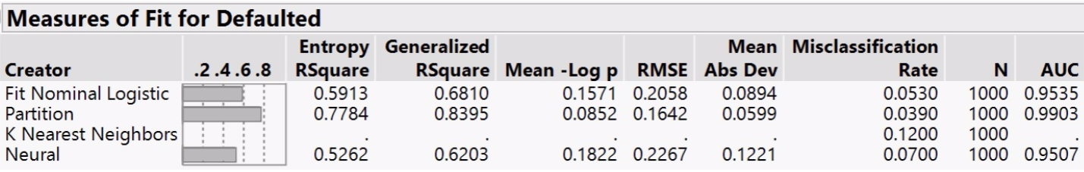
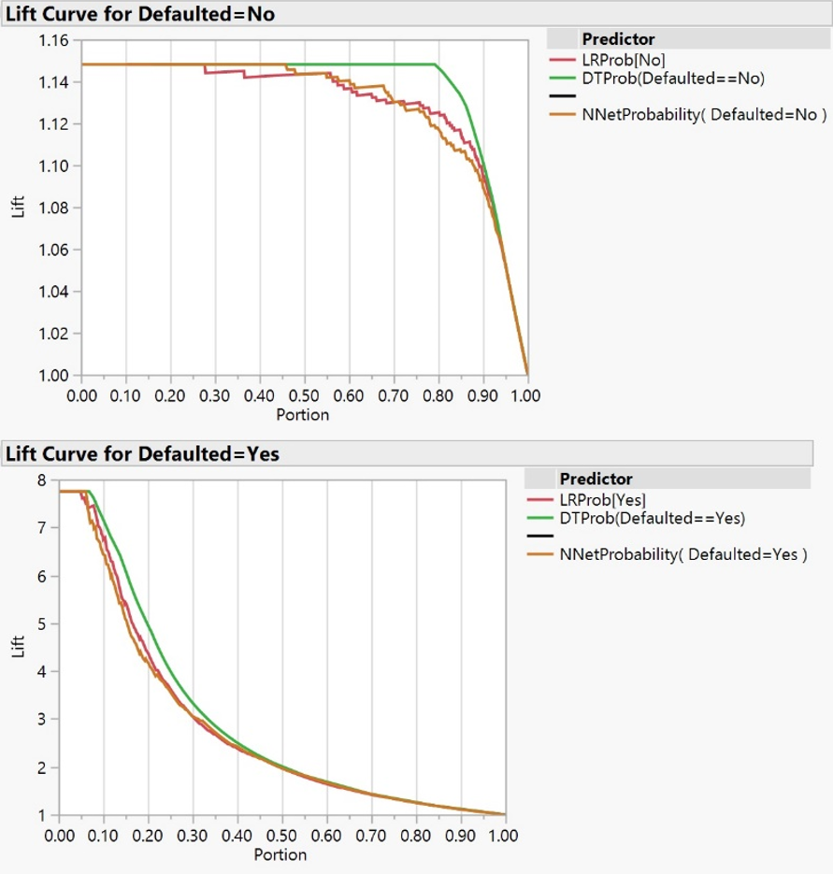
MODEL COMPARISON (Cont.)
Receiver Operating Characteristics (ROC)
Measure | Logistic Regression | Decision Tree | Neural Networks | K-Nearest Neighbor
AUC = No | .95 | .99 | .95 | 0
AUC = YES | .95 | .99 | .95 | 0
Confusion Matrix
Parameter | Logistic Regression | Decision Tree | Neural Networks | K-Nearest Neighbor
Accuracy | .95 | .96 | .96 | .88
Sensitivity | .69 | .85 | .50 | .07
Specificity | .99 | .98 | .99 | .99
Notes:
From the Model comparison, it is obvious that with respect to fit measures, the decision tree (which is listed in the Measures of fit as partition) has the highest R-Square value of 0.84, lowest RMSE of 0.16, lowest log likelihood of 0.0852, lowest Mean Abs dev of 0.06 and lowest misclassification rate of 0.04. The decision tree also has the highest AUC 0.99, highest accuracy value of 0.96, highest sensitivity value of 0.85 and a high specificity value of 0.98 which is comparable to that of the other models. The lift chart also reveals that the decision tree curve (shown in green) has the highest lift.

Slide 13
CONCLUSION
As can be seen from the comparison results, the Decision tree model performed better than the other models in terms of Fit measures, Area-under-curve from the ROC, Confusion Matrix as well as the Lift Chart.
Logistic regression followed closely with comparable results. Neural networks rated high in most areas, with the exception of sensitivity, while k-nearest neighbor resulted in the lowest performance.
Other notable findings through our analysis was that the independent variables relating to the total amount of payments that a borrower had made and the amount of the loan had the strongest relationship with the response variable. Throughout all analysis models, these two variables returned the highest degree of correlation to the response variable than any other model.
Recommendations:
The higher the loan amount, the higher the likelihood of default Choose loans that $9000 or less.
Loans with term of 36 months tended to be defaulted a lot more than loans with term of 60 months. Choose loans with 60 month terms.
Certain sub-grades were almost certain to default compared to other sub-grades. Selecting loans of subgrade B5 and higher will result in a 90% chance of repayment.
Notes:
Thus, we can see that the Decision tree model comes up with the best score for predictive capability as compared to the other three models for this particular data set. Logistic regression followed closely with comparable results. Neural networks rated high in most areas, with the exception of sensitivity, while k-nearest neighbor resulted in the lowest performance. Other significant findings were that independent variables relating to the total amount of payments that a borrower had made and the amount of the loan had the strongest relationship with the response variable.
From our data mining analysis we have the following recommendations for investors:
Take note of the requested loan amount. Although a higher loan principle equates to larger gains from interest, higher loan amounts also equates to a higher likelihood of default. We found that this risk of default increases exponentially for loan amounts over $9,000. Choose loans that $9000 or less.
A borrower that chooses a short term for the life of a loan implies that they are committed to paying off the debt as quickly as possible. It suggests that they have the means to handle the higher monthly payment. However, we have found that the shorter loan term had more defaults than the lengthier term. The longer term loan translates to borrowers having the ability to budget around the smaller monthly payment, and the investor benefiting from longer living cashflow on his investment. Choose loans with 60 month terms.
3) While lower subgrades equate to higher interest rates we found that they also significantly increase the likelihood of default. Selecting loans of subgrade B5 and higher will result in a 90% chance of repayment.

Slide 14
Thank You!
Notes:
This concludes our presentation. Thank you for taking the time to view it. We hope that you found the story that we unlocked from the Lending Club loan data to be informative and useful.

